Slide 1


PAYROLL MANAGEMENT SYSTEM
GIDED BY :
MR. BHABANI SANKAR SAHU
Presented by :
BAKSHI JANARDAN PADHY
BHABASHANKAR PRADHAN
DYUMATSEN SAHU
GHANASHYAM JENA
SHANKAR CHAITAN JANA
MONALISA DAS
Month :- August
Year :- 2022

Slide 2
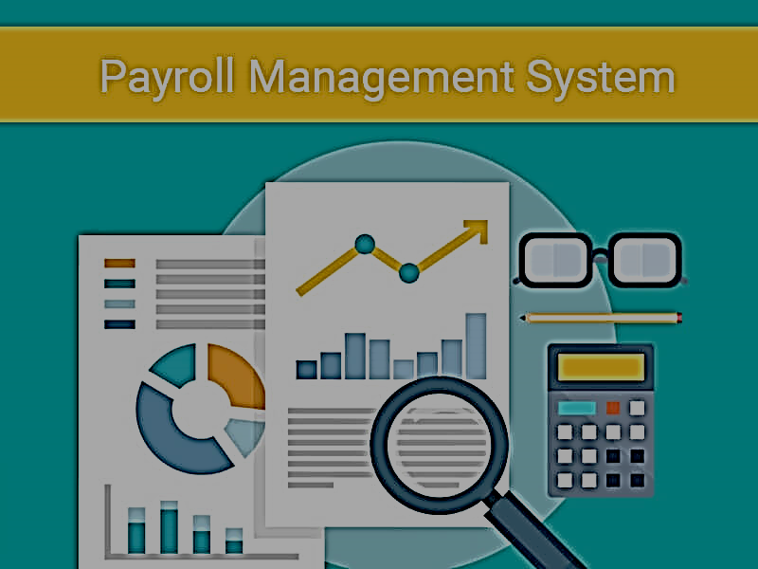
CONTENT :
1. Introduction about project
2. Objective of the project
3. Hardware and Software requirements
4. About C
5. Flowchart
6. Source Code
7. Output
8. Conclusion

Slide 3

INTRODUCTION ABOUT THE PROJECT :
A Payroll Management System is a Software that is used to manage all your employee’s financial records in a simple and automated fashion. This Payroll management System manages employee’s salaries, deductions, other conveyance, net pay, bonuses and generation of pay-slips, etc.
Payroll consists of the process by which a business pays its employees for work performed during a specific period. A payroll system allows businesses to follow a set series of processes in order to make timely, correct payments in compliance with government regulations.
A Payroll system may be manual or computerized and handled in-house or autsoureced to another provider. Some smaller businesses conduct thir payroll using a manual system. While inexpensive, this method may increase the chances of errors and could prove time-consuming for companies with more than a few employees.

Slide 4
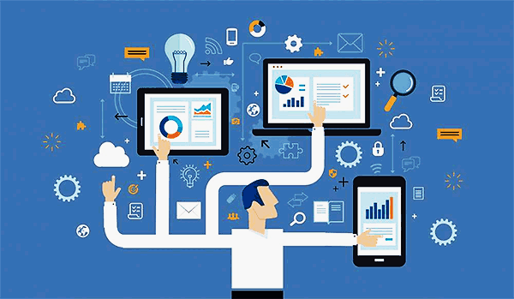
OBJECTIVE OF THE PROJECT :
The Objective of the Payroll System. The Payroll Management System is a set of processes that helps you streamline salaries, bonuses, deductions, taxes, and other necessary aspects of the net pay of all the employees in your organization.
The main objective of the payroll management system is to manage the details of payments, salary, working points, Appraisals, payroll. It manages all the information about payments, Employee, Payroll, payment. The Project is totally built at administrative end and thus only the administrator is guaranteed the access.
The aim behind having a payroll management system is to automate and streamline micro tasks such that the HR team has time to focus on the macro tasks.
You don’t have to worry about handling, managing, and creating pay slips, salaries, and deductions of the employees. The tax deductions are also automated or handled by the outsourcing team. You only have to focus on major tasks such as the efficiency of sales, revenue, strategy, etc.

Slide 5
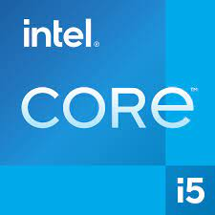
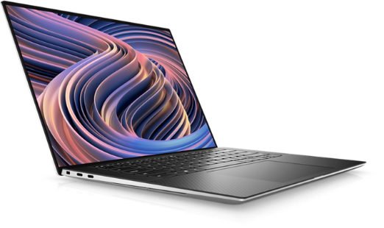
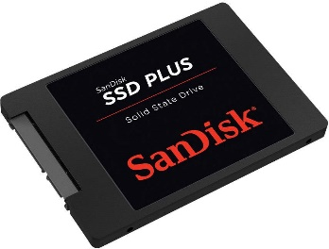
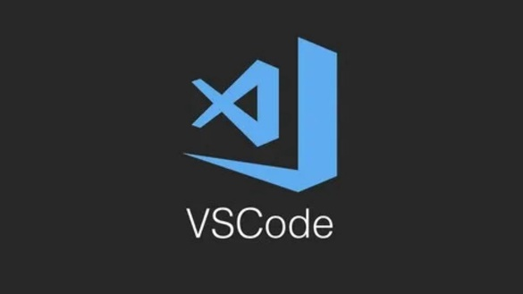

HARDWARE AND SOFTWARE REQUIREMENTS :
Hardware :
Operating system : Window 11 /Any generation window O/S.
SSD : 512GB
RAM : Minimum Requirement
Processer : CORE / Ryzen
Software :
Programming language : C Language
IDE : VS Code (Visual Studio Code)/Any user
friendly and supported by C language IDE
Compiler : GCC (GNU Compiler Collection)/And
Any C supporting compiler

Slide 6

ABOUT C :
Dennis Ritchie is known as the founder of the c language.
C programming language was developed in 1972 by Dennis Ritchie at bell laboratories of AT&T (American Telephone & Telegraph), located in the U.S.A.
C programming is considered the base for other programming languages, that is why it is known as the mother language.
C is one of the fastest programming language as it is close to low-level languages such as Assembly language.

Slide 7
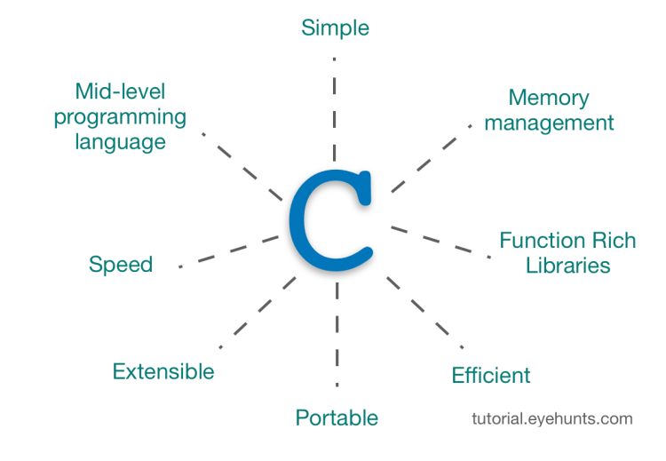
Features of C Language :
Simple
Machine Independent or Portable
Mid-level programming language
structured programming language
Rich Library
Memory Management
Fast Speed
Pointers
Recursion
Extensible

Slide 8
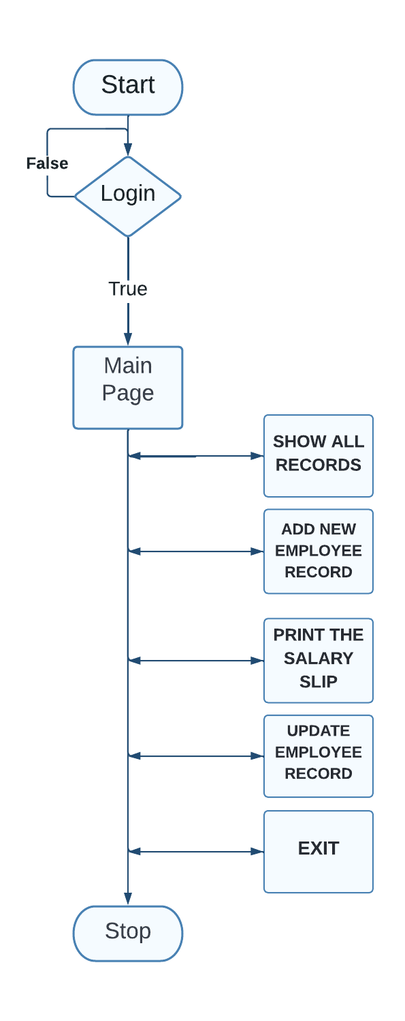

Flowchart :

Slide 9
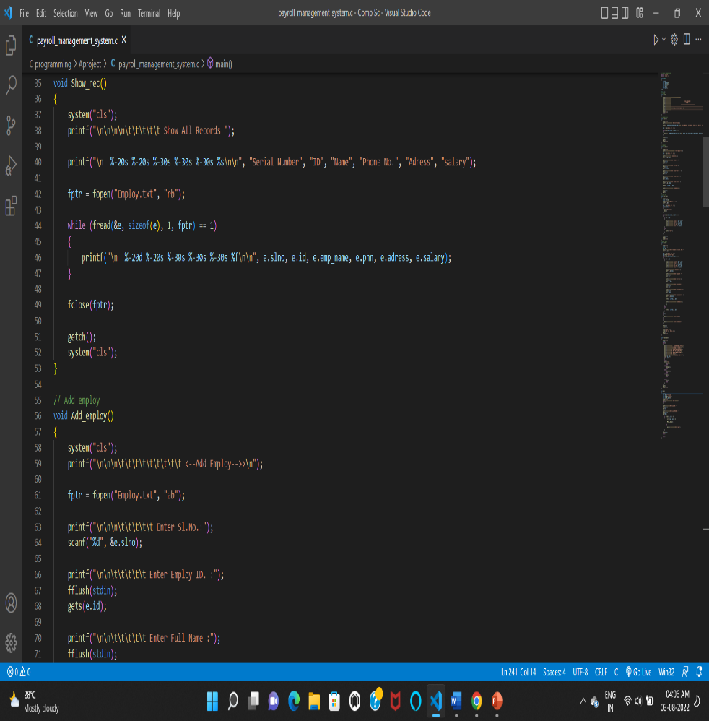
SOURCE CODE:
Functions use in this project:-
welcom() :- This Function used for print user welcome part.
Show_rec() :- This Function used for show all employs distils.
Add_employ() :- This Function used for add new employ.
print_slip():- This Function used for print single employ distils.
update() :- This Function used for update any employ data.
Manage_employ():- This Function is main function all functions are called in this function and choose opportunity.
main() :- in main function login and Manage_employ() are coded in this function

Slide 10
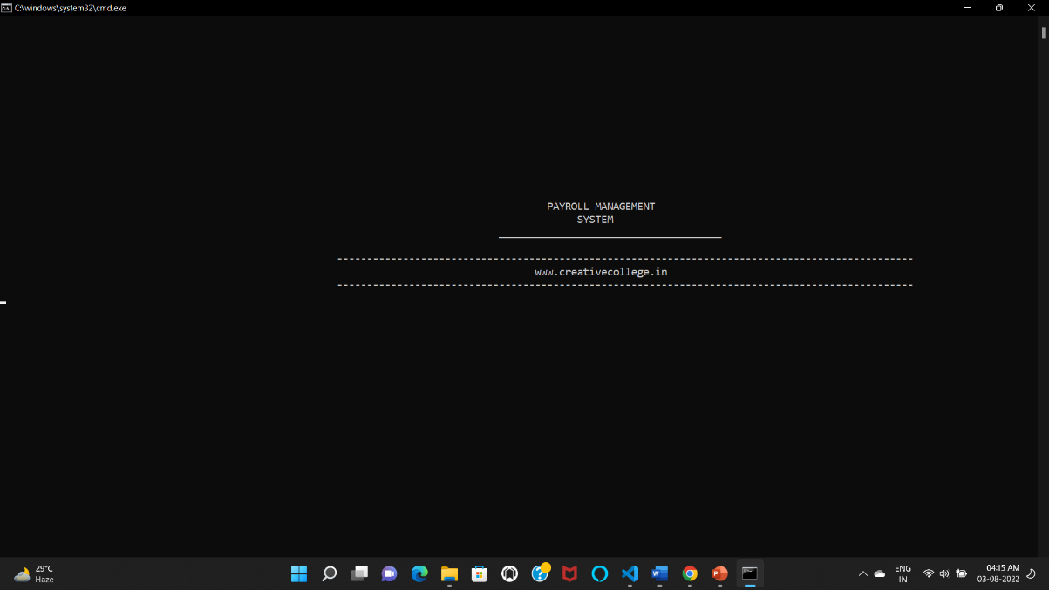
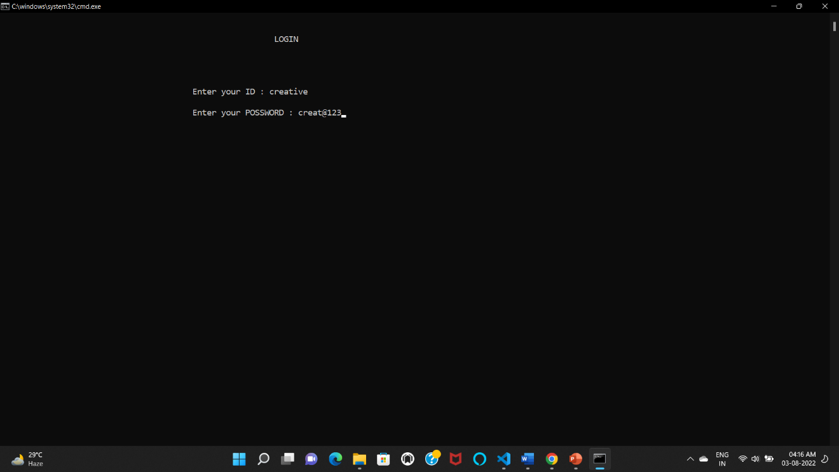
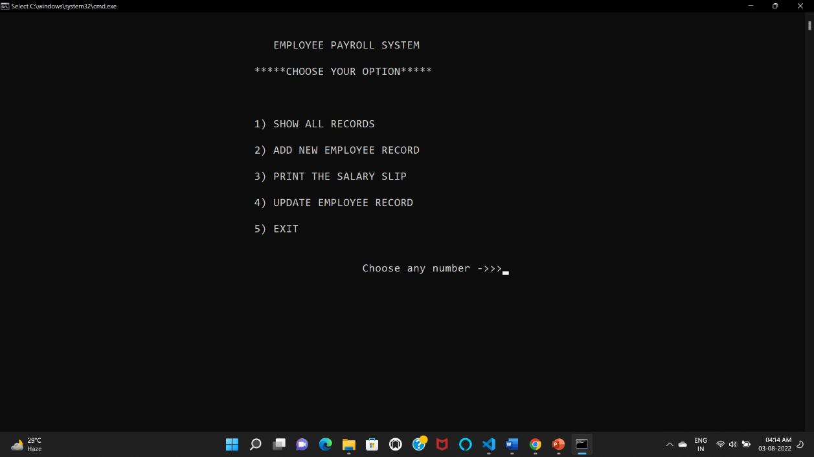
OUTPUT :

Slide 11
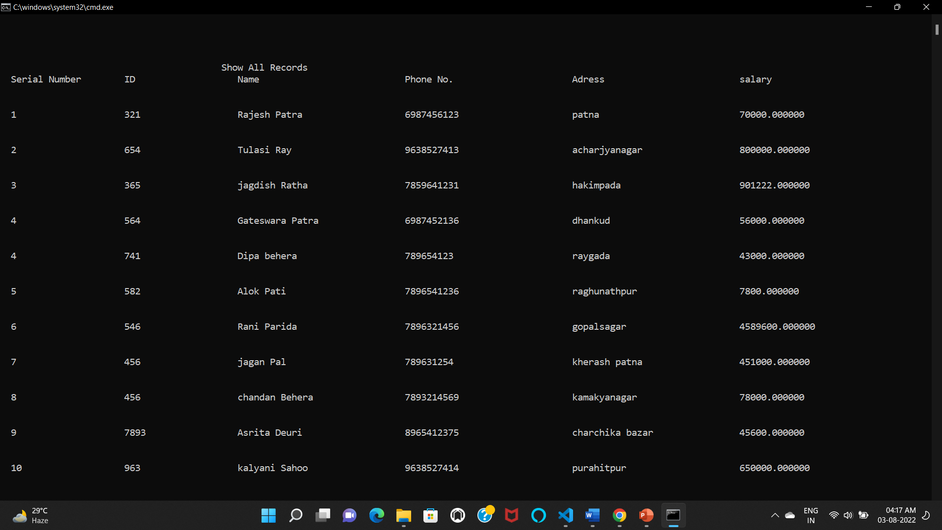
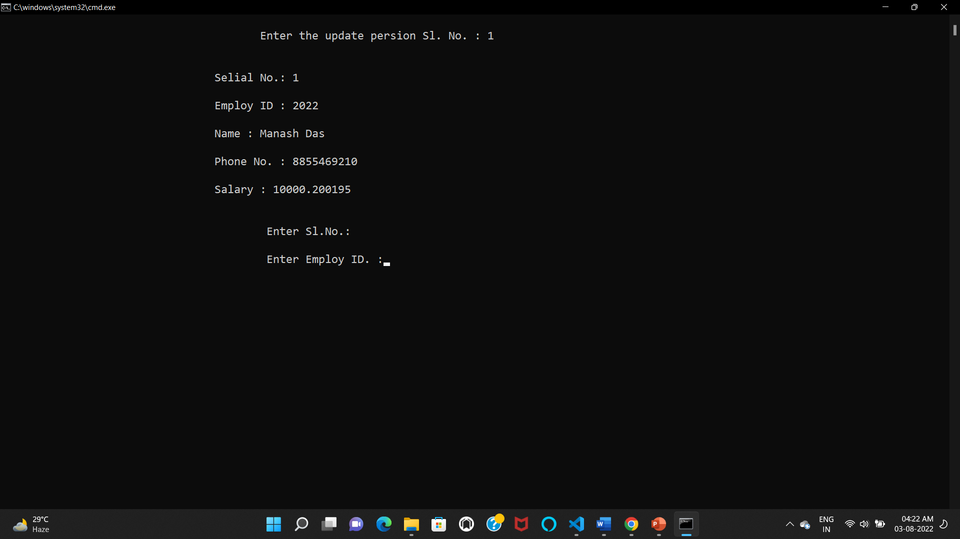

Slide 12

CONCLUSION :
Payroll Management System is developed for a company has been designed to achieve maximum efficiency and reduce the time taken to handle the Payroll activity.
It is designed to replace an existing manual record system there by reducing time taken for calculation and for storing data.

Slide 13

THANK YOU!

